Slide 1
Options Trading Competition
Week 3

Slide 2
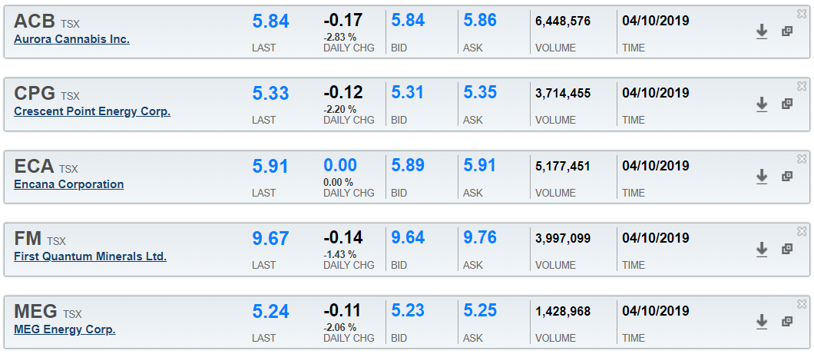
What Happened Last week:
Exercise and assignment of First Quantum and CPG bear put spreads.
Both expire ITM
A look at current position standings and current quotes:

Slide 3
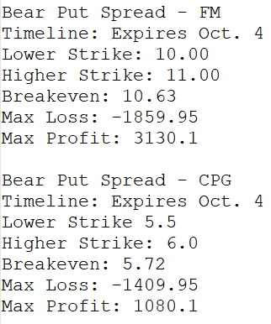
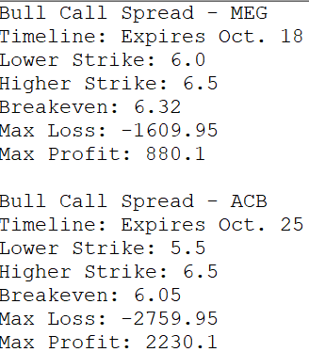
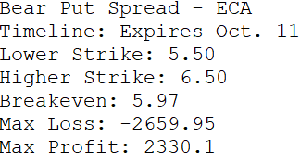
Refresher on OUR Positions

Slide 4
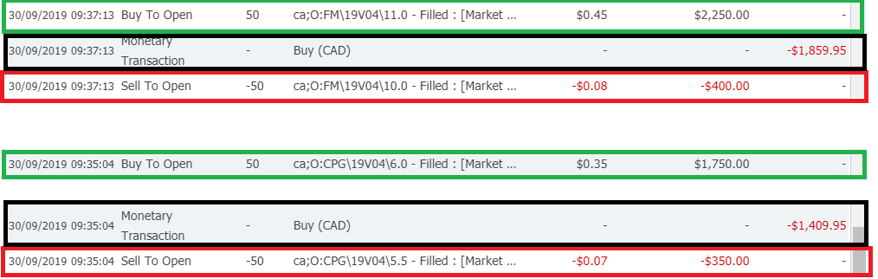
Entering those positions
As we had calculated, the total cost of the CPG transaction was $1409.95 and the total cost of the FM transaction was $1859.95.

Slide 5
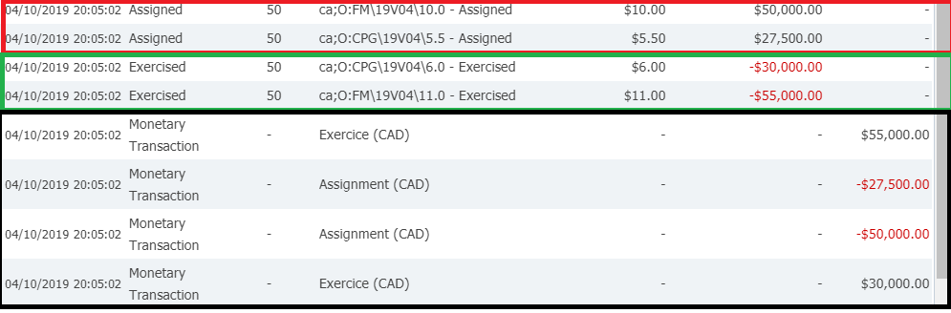
Exercising and assignment
The total cash attained from the exercise and assignment was:
$55,000 + $30, 000 - $27, 500 - $50,000 = $7,500
Subtracting the initial cost of the transaction:
$7,500 – $1,409.95 – $1,859.95 = $4,230.1 profit

Slide 6
OverVIew on positions
MEG: Max loss by far, two weeks until expiry.
ACB: Uncertain as of now, 3 weeks until expiry.
ECA: Uncertain, slightly ITM, expires this week.

Slide 7
Margins
An additional metric that we did not think of is the margin
Margin is the amount of money borrowed from a brokerage firm to purchase an investment.
It is the difference between the total values of securities held in an investor’s account and the loan amount from the broker.
Ex. We purchase 50 options on RY trading at $105 a share. Each option contract is for 100 shares. This means that if the option executes, we will be entering a long position worth $105 * 100 * 50 = $525 000. We clearly do not have this much money in our account, however, if this option executes, it means it’s ITM, which means we can sell it immediately at market price and make a profit.
The broker trusts that we will do this, or if it goes into the negatives such that our account cannot cover it, we will be margin called, and positions will be liquidated.
We are allowed 5 margin calls in this competition.
Notes:
-We are going to have to focus on holding options positions until expiry.

Slide 8
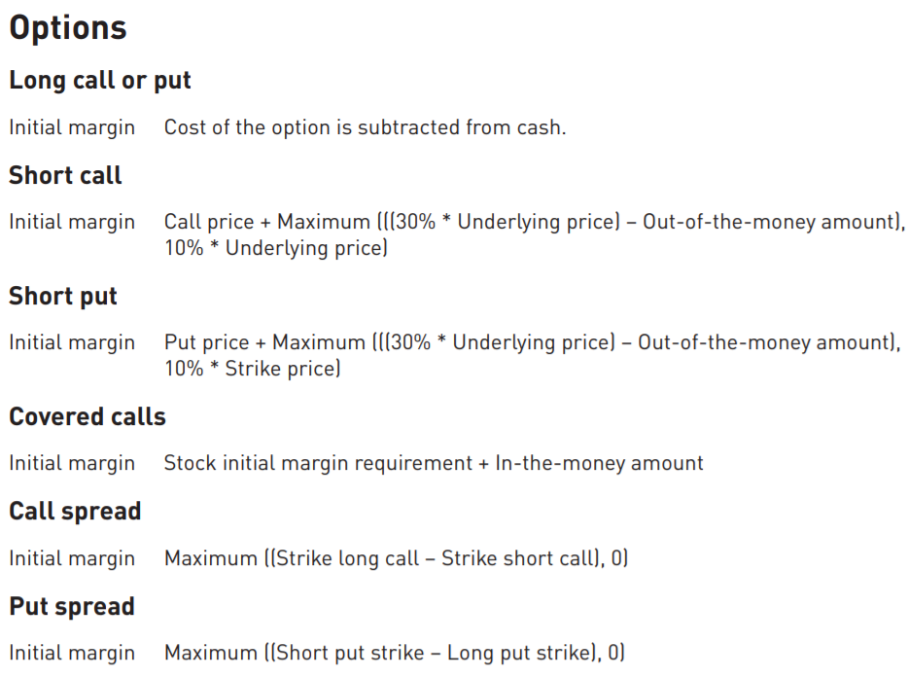
Margins
Margins for our purposes
What does this mean?
Notes:
-We are going to have to focus on holding options positions until expiry.

Slide 9
Risk-Reward ratio
When we are right, we want to get the maximum reward we can
When we are wrong, we want to lose the minimum amount we can
On the FM trade we had good risk-reward
Even if we only won this trade 38% of the time, we would make money
This trade was made 60 cents out of the money
How often should we expect to win this trade?
On the CPG trade, we did not have great risk-reward
We would have to win this trade 57% of the time to make money
This was still a pretty good trade as it was already ITM when we purchased it
How often should we expect to win this trade?
Implementing this calculation?

Slide 10
Key Takeaways:
Let’s decide on 2-3 trades that will expire at the end of this week.
Not sure what the consensus on margin is. I suggest we see how it works firsthand.
Keep in mind our ECA trade is expiring this Friday.
As Holidays approach, keep in mind price usually goes down before holidays and goes up after holidays

